Slide 1


Understanding Perceptions of Twitter User Towards Precaution Dose COVID-19 Vaccine
- Payal Sakhre

Slide 2
CONTENT
Introduction to the COVID-19 context
Key Objectives
Methodology
Study Design
Data Retrieval and Preprocessing
Coding of the Data
Codebook
Search Strategy
Detailed Analysis of Key Tweets Extracted Using Search Strategy 2
Classification Tweet
Sentiment Analysis Of Tweets
Result
Discussion
Workflow for tweet analysis
Reference

Slide 3
Introduction to the COVID-19 Context
The COVID-19 pandemic began in late 2019, causing a global health crisis. Non-pharmaceutical interventions such as facemasks and social distancing were initially used to reduce viral transmission.
WHO reported over 567 million confirmed cases and 6.3 million deaths globally.
In April 2022, the Indian government initiated a 75-day campaign called 'COVID Vaccination Amrit Mahotsava' offering free precaution doses to adults 18 years and older. Boosters enhance immune response, critical for maintaining protection against evolving variants.
The CDC reported that 27.1% adults and 18.5% adolescents took the booster dose in September 2022, with 39.4% of adults and 52.0% of adolescents having parents open to booster vaccination.
Vaccination emerged as a vital long-term protective measure, with multiple vaccines receiving emergency use authorization in India by mid-2022, including Covishield and Covaxin among others.
Social media platforms like Twitter provide valuable data reflecting public attitudes, including vaccine hesitancy, useful for policy and public health planning.

Slide 4

Key Objectives
01
To examine public discussions and sentiments on Twitter regarding the COVID-19 precaution dose
02
To identify key themes and patterns reflecting vaccine hesitancy and acceptance among Indian users.
03
To analyze the influence of government vaccination campaigns on public perception.
04
To derive insights that can guide policy formulation and improve public health outreach regarding COVID-19 booster vaccination.

Slide 5



Gather twitter data
Conduct data cleaning
Reorganize the data
Conduct data exploration
Coding relevant information in the data
Generate themes to address the objectives
Methodology: Data Collection and Study Design
Study Design
A retrospective design was employed using existing English tweets. Keywords, hashtags, and government handles were included following stakeholder consultation to maximize relevance.
Data Retrieval
Tweets were extracted using two search strategies differentiating the use of 'OR' and 'AND' operators on terms "precaution" and "booster dose," focusing on data from India, July–August 2022.
Analysis Approach
Initial content analysis and thematic coding established a framework to analyze tweet perceptions and generate themes addressing the study objectives.
Fig 1: Flowchart outlining the methodology

Slide 6
DATA RETRIEVAL AND PREPROCESSING
1
2
3
4
5
Tweets on COVID-19 and precaution dose were extracted under the study titled ‘Sentiment analysis of Twitter posts about COVID19 precaution dose between July 2022 and November 2022’. Of these, tweets from the month of July and August were used for the present study.
Two search strategies were used to extract the tweets.
Search Strategy 1 – “OR”
Search Strategy 1 – “AND”
The first strategy was expected to produce a large number of results (many of which would possibly be irrelevant).
Our plan involved analyzing exclusively the text content of the collected tweets using Search strategy number #1. Our aim was to establish specific codes and generate a coding frame based on this larger dataset.
To facilitate the extraction of key tweets, we employed another search strategy (Search strategy number #2).
By utilizing the 'AND' operator, we aimed to minimize the inclusion of irrelevant tweets, resulting in a limited number of highly relevant tweets that could be thoroughly analyzed.
The standard Twitter API – Tweepy tweeter version 2 library in python version 3.8.10.

Slide 7
Search Strategies for Tweet Collection
Table 2: Search Strategy 1:
Table 3: Search Strategy 2:
Duration | July And August 2022
Location | India
Search Terms | Precaution OR Booster Dose
Language | English
Govt & Govt Collaborators | @Mohfw_india @ICMRDELHI @Officeof_mm @Mansukhmandviya @_Digitalindia @Nhmbhadrak @Goi_meity @Pib_india @Unicefindian@mib_india
News Channels | @Ddnewsliven @ANI @Pti_news @Pbns_india @Pbns_hindi @Pbsc_beijing
Frequently Used Hashtags | #Azadikaamritkaal #Covid19vaccination #2yearsofvaccinedrive #Covidisnotover #Amritmahotsav #Breakingnews #Digitalindia
Duration | July And November 2022
Location | India
Search Terms | Precaution AND Booster Dose
Language | English
Govt & Govt Collaborators | @Mohfw_india @ICMRDELHI @Officeof_mm @Mansukhmandviya @_Digitalindia @Nhmbhadrak @Goi_meity @Pib_india @Unicefindia @Mib_india
News Channels | @Ddnewslive @ANI @Pti_news @Pbns_india @Pbns_hindi @Pbsc_beijing
Frequently Used Hashtags | #Azadikaamritkaal #Covid19vaccination #2yearsofvaccinedrive #Covidisnotover #Amritmahotsav #Breakingnews #Digitalindia

Slide 8
Why Qualitative Analysis Over ML
Machine learning approach
- It could provide insights based on patterns and correlations in data.
- The nature of ML is analyze quantitative, automated, data driven
- The strength of ML is fast, scalable, objective pattern recognition
- Limitations: may miss nuance, dependent on algorithm quality, Increased complexity, and Difficulty in diagnosing and correcting prediction errors due to algorithm complexity
Qualitative analysis
- It allows for a deeper understanding of complex phenomena that cannot be captured by quantitative methods alone.
- It could provide context and meaning to those patterns.
- The strength of qualitative analysis is context rich, deep insights, and flexible
- Limitations: time consuming, smaller sample size, subjective.

Slide 9
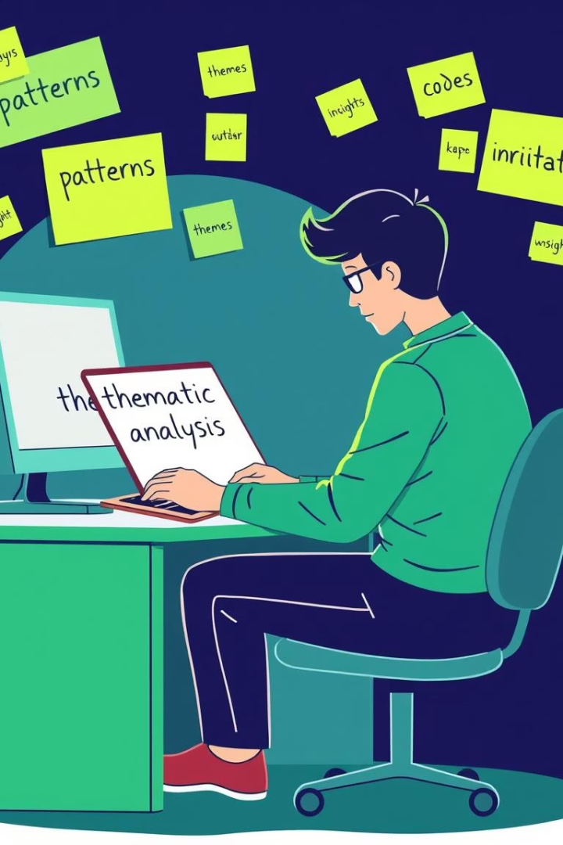
Codebook Development and Qualitative Analysis
Qualitative Coding
Content and Thematic Analysis
Tweets were manually coded line-by-line to capture complex nuances beyond machine learning capabilities, allowing rich thematic development.
These methods uncovered underlying patterns and meanings within tweets, supporting an in-depth understanding of public perceptions.
Codebook Structure
The initial codebook included themes, descriptions, sub-themes, and example statements, serving as a reference for consistent analysis.

Slide 10

Table 1: This table showed the format of the initial version of the codebook.
Themes | Description | Sub-themes | Statement

Slide 11
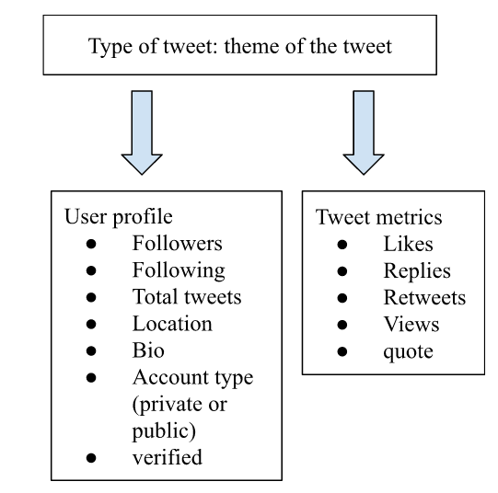
Detailed Analysis of Key Tweets Extracted Using Search Strategy 2
Identified themes for all tweets from Search Strategy 1
For the data obtained from Search Strategy 2, we conducted a detailed, in-depth analysis to understand the discussion around, context, and dissemination of the tweet.
Classified tweets into types.
We classified the tweets into types: tweet, retweet, reply, quote tweet.
Examined various metrics.
We examined metrics associated with the primary tweet including likes, comments, retweets, quote, views, and any attached documents.
Fig 2: The workflow for conducting a detailed analysis of tweets extracted using search strategy 2 focuses specifically on original tweets.

Slide 12
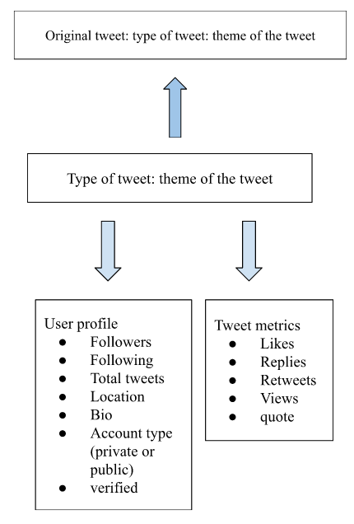
Fig 3: The workflow designed for performing an in-depth analysis of tweets obtained through search strategy 2: This was specifically customized to address situations in which the extracted tweet was either a reply or a quote retweet.

Slide 13
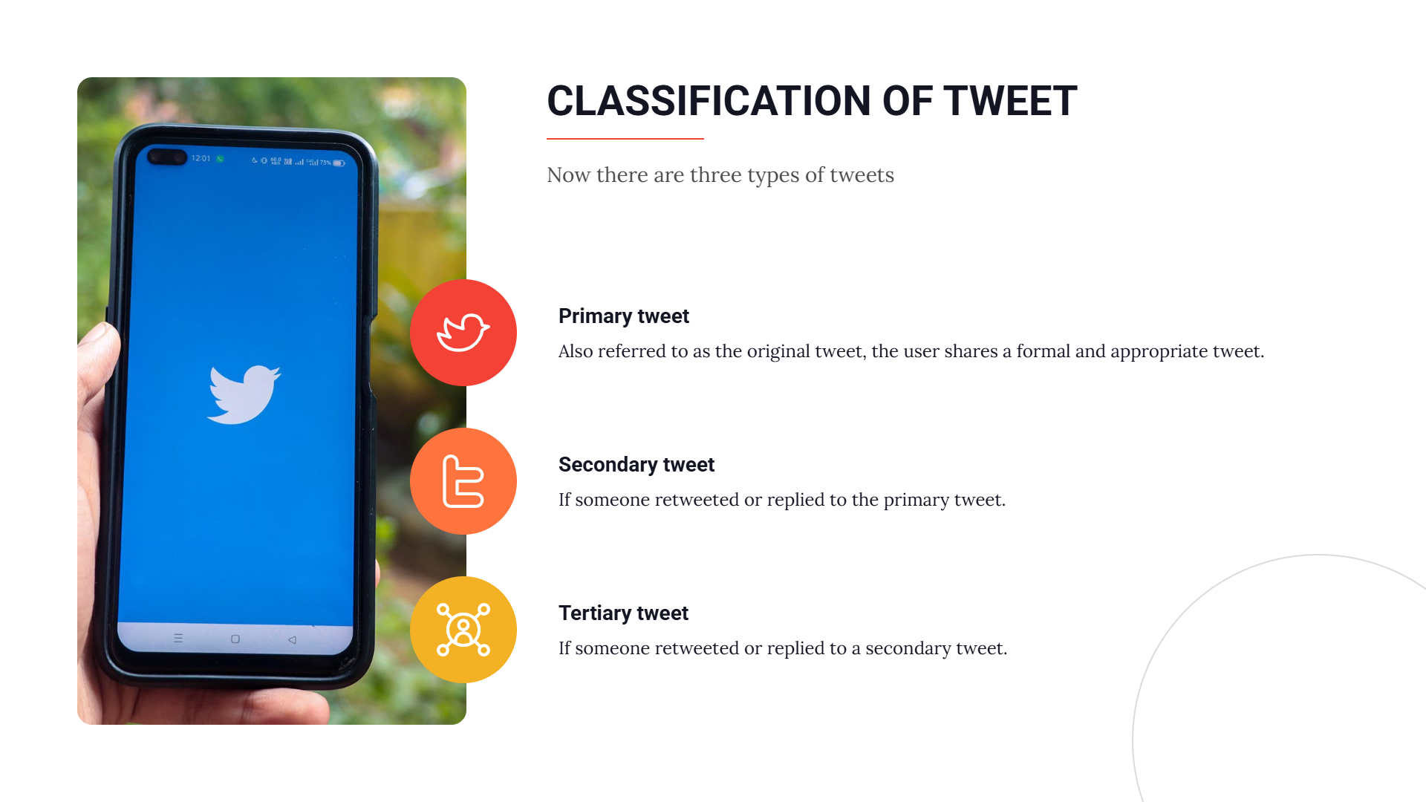

Slide 14
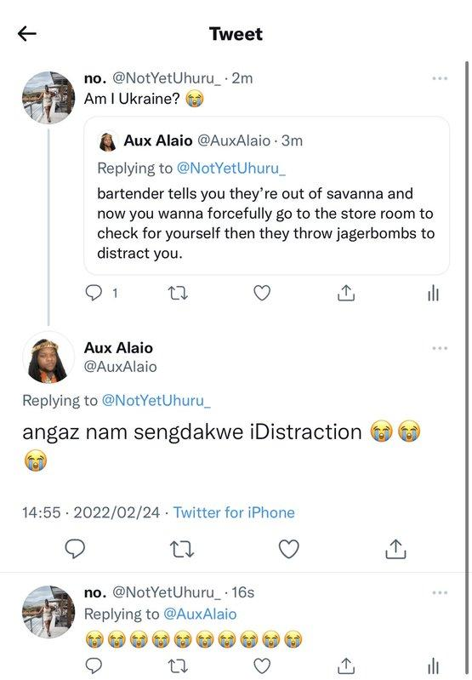
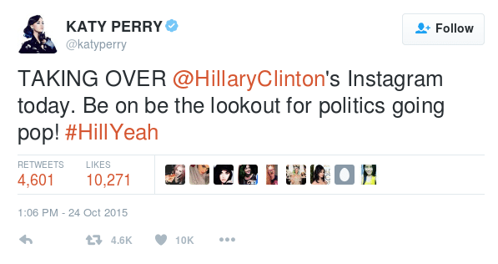
Fig 4: Representation of primary tweet
Fig 6: Representation of Tertiary tweet

Slide 15
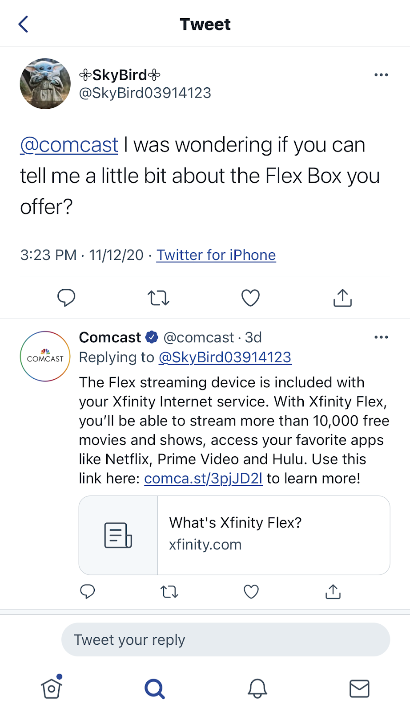
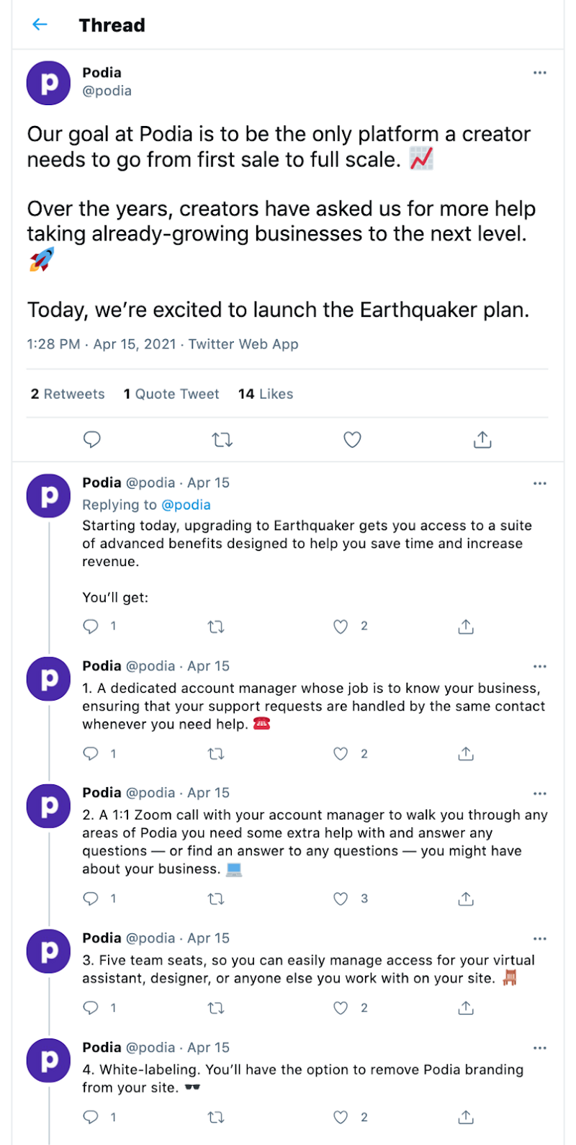
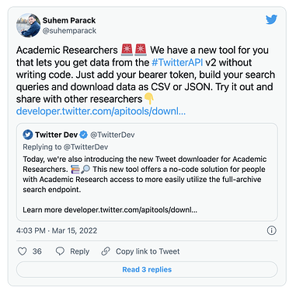
(a)
(b)
(c)
Fig 5: Representation of secondary tweet (a) reply (b) thread (c) quote tweet

Slide 16
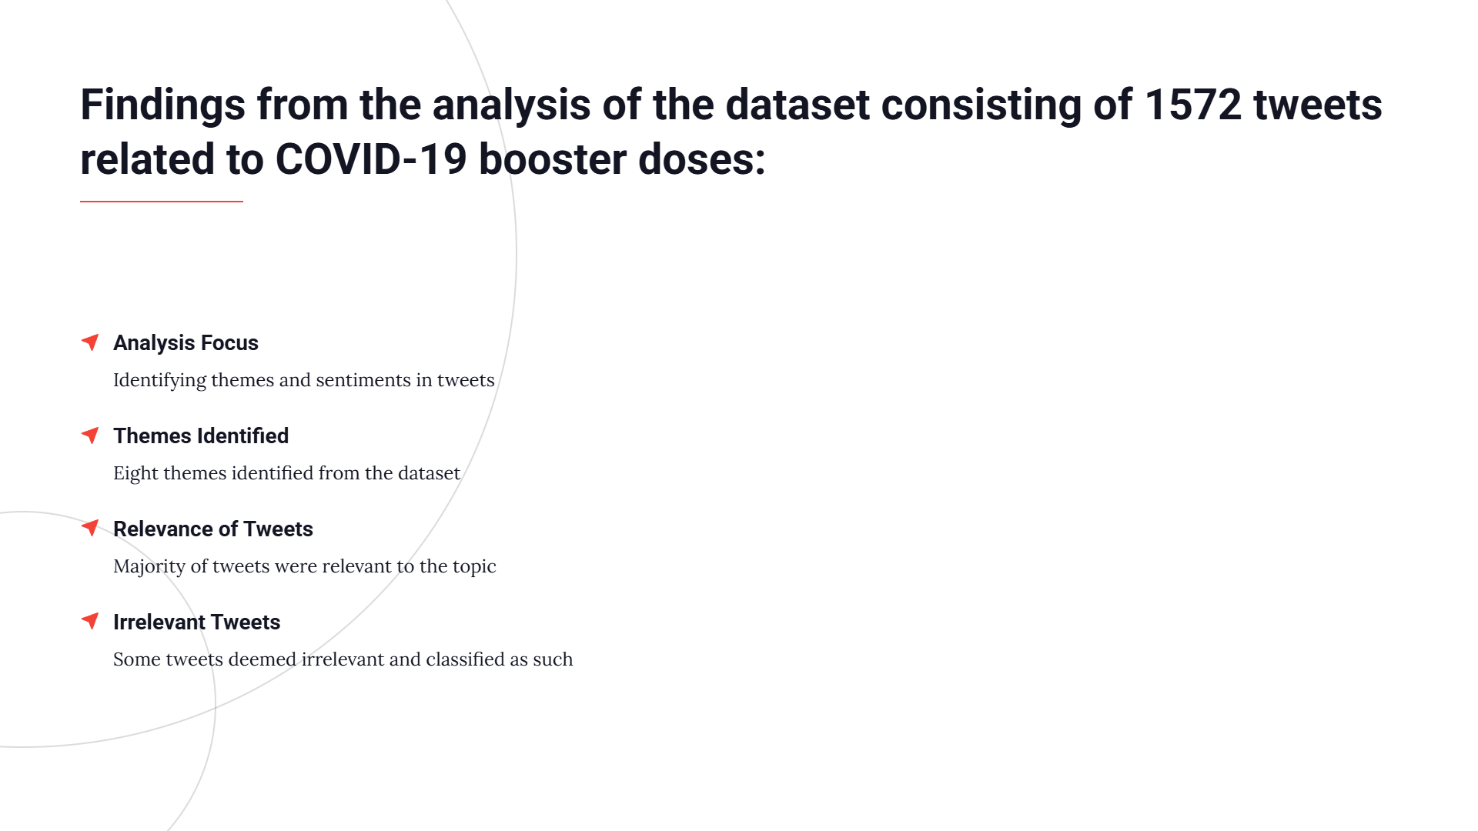

Slide 17
Search Strategy 2 Yielded 36 Key Tweets
Themes | Codes | Sub-codes
1. Resources | 1.1 News
 | 1.2 Alert
 | 1.3 Information
 | 1.4 Update
 | 1.5 Awareness And Education
2. Discussion | 2.1 Argument
 | 2.2 Despair
 | 2.3 Suggestion
 | 2.4 Caution/Care
 | 2.5 Query/Curious
 | 2.6 Sarcastic
 | 2.7 Experience | 2.7.1 Gratitude/Appreciative
 |  | 2.7.8 Proud Feeling
 | 2.8 Misinformation
3. Concern | 3.1 False Message
 | 3.2 Side Effects
 | 3.3 Vaccine Unavailability
 | 3.4 Certificate Issues
4. Opinion
5. Evidence | 5.1 Speculation Of Vaccine
6. Promoting Vaccine | 6.1 Vaccination Camp
 | 6.2 Booster Schedule
 | 6.3 Vaccination Promotion
 | 6.4 Incentivization
 | 6.6 Appeal/Request
 | 6.7 Encouragement
7. Unclassifiable
8. Irrelevant

Slide 18
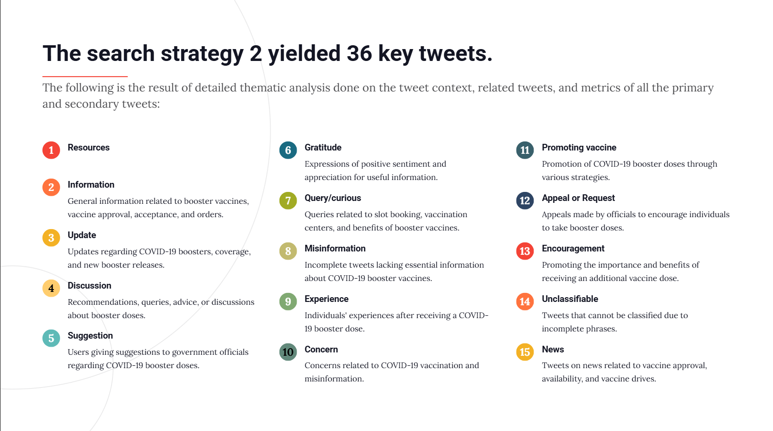

Slide 19
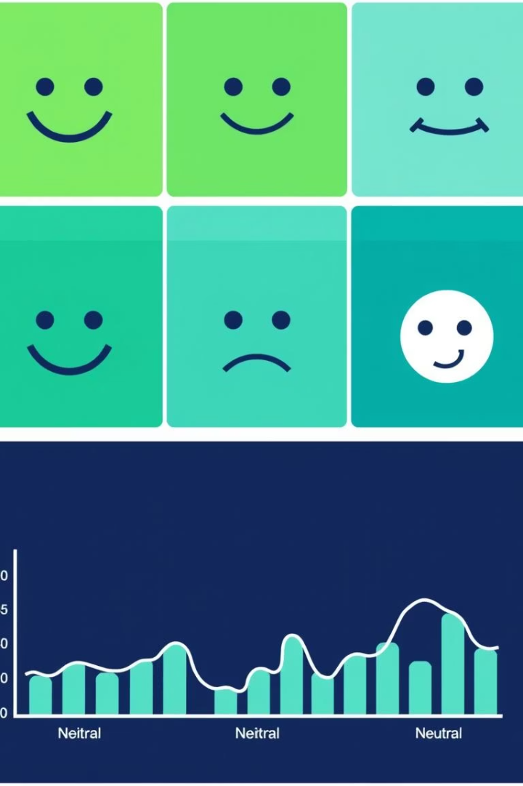
Sentiment Analysis and Engagement Patterns
Sentiment Classification
Findings
Positive tweets revealed supportive perceptions, while negative sentiments reflected hesitancy and vaccine concerns.
Tweets were labeled as positive, negative, or neutral to assess public attitudes and engagement about the precaution dose.
Neutral sentiments included informative or non-opinionated discourse.
Influence of User Type
Government and public figures' tweets had wide reach, often shaping public opinion and discourse dynamics.

Slide 20
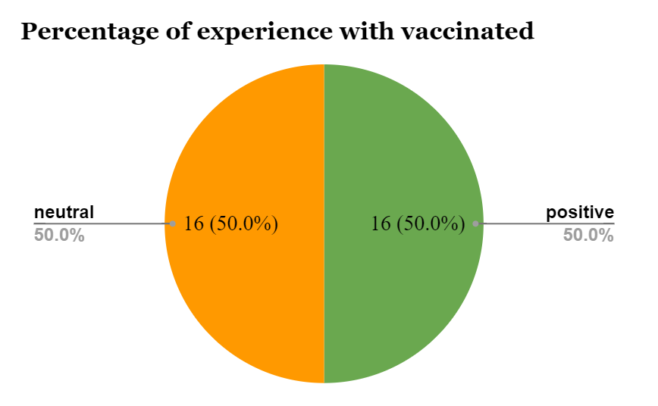
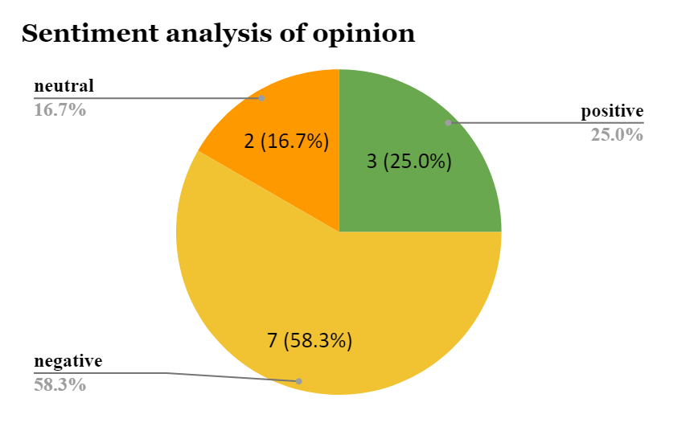
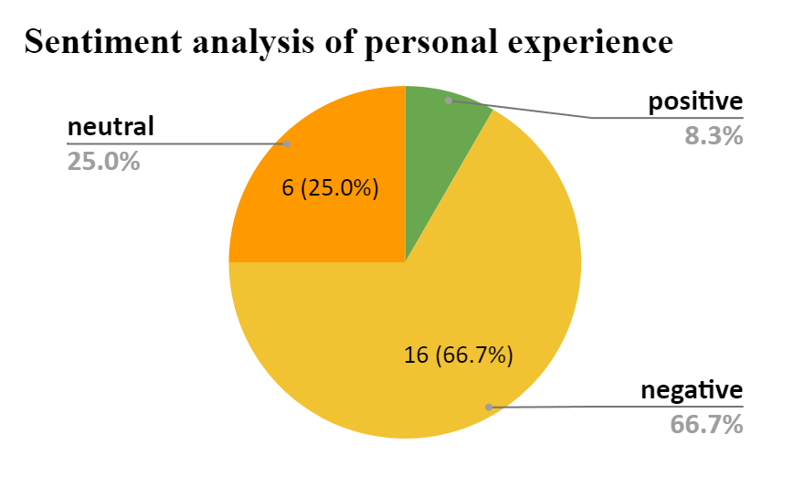
Graphical Representation of Experience and Opinion
Table 6: sentiment analysis of two themes: experience and opinion
Personal experience: direct encounter with a situation or event
Opinion: subjective viewpoint or belief about a matter
Personal experiences come from firsthand knowledge
Opinions are formed through individual thoughts, values, and biases
Both personal experiences and opinions shape understanding and perspective on various topics.
Vaccinated | Positive | 16
 | Neutral | 16
Personal Experience | Positive | 2
 | Negative | 16
 | Neutral | 6
General Opinion | Positive | 3
 | Negative | 7
 | Neutral | 2

Slide 21
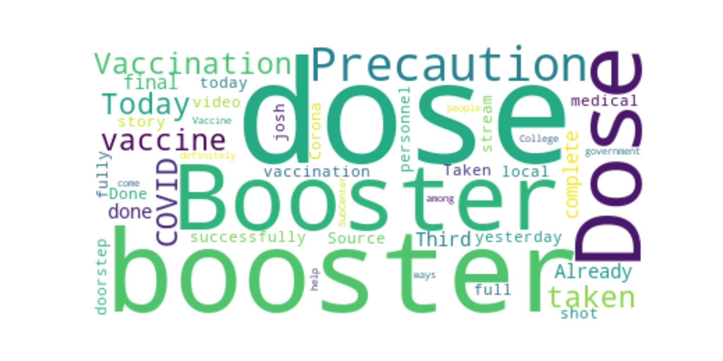
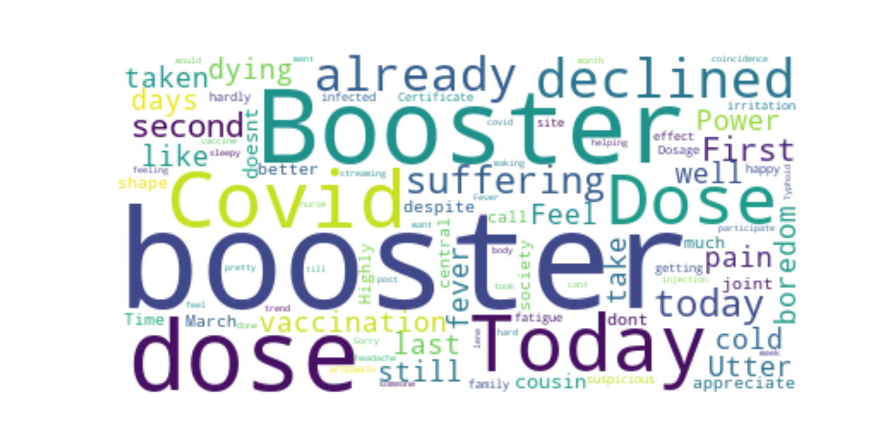
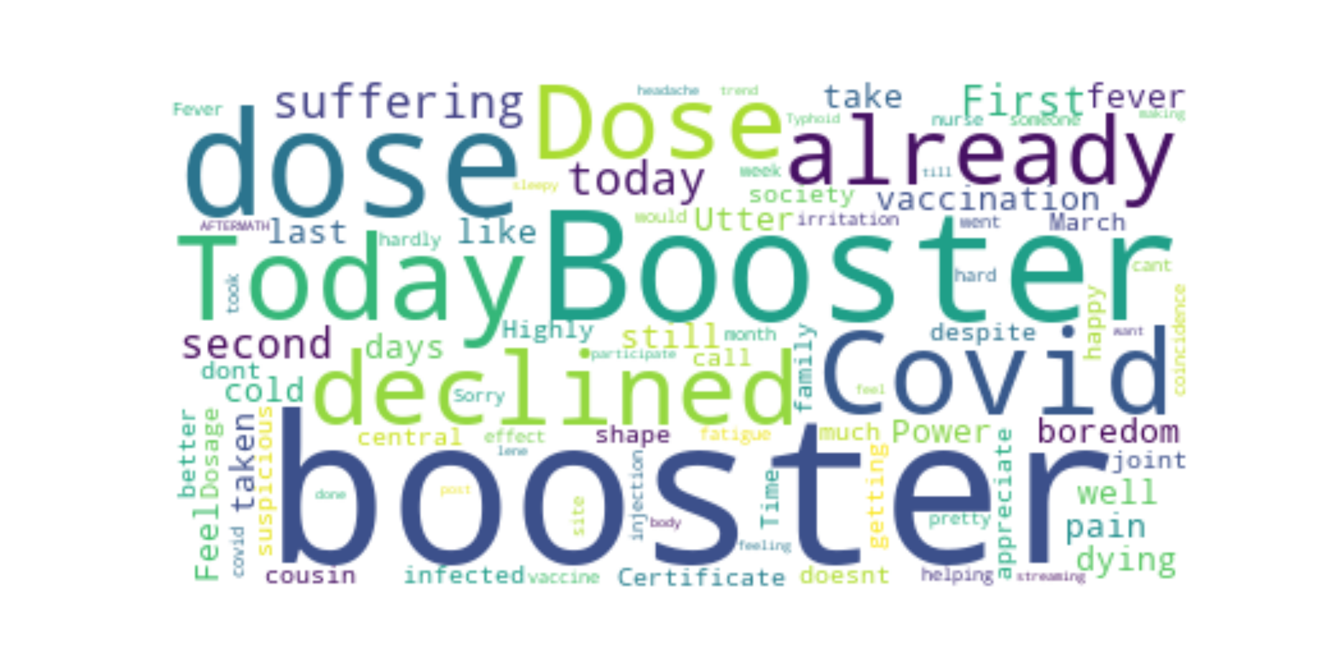
Word Cloud of tweets under the theme ‘experience’ and ‘vaccinated’
Word Cloud of tweets under the theme ‘personal experience’
Word Cloud of tweets under the theme ‘opinion’

Slide 22
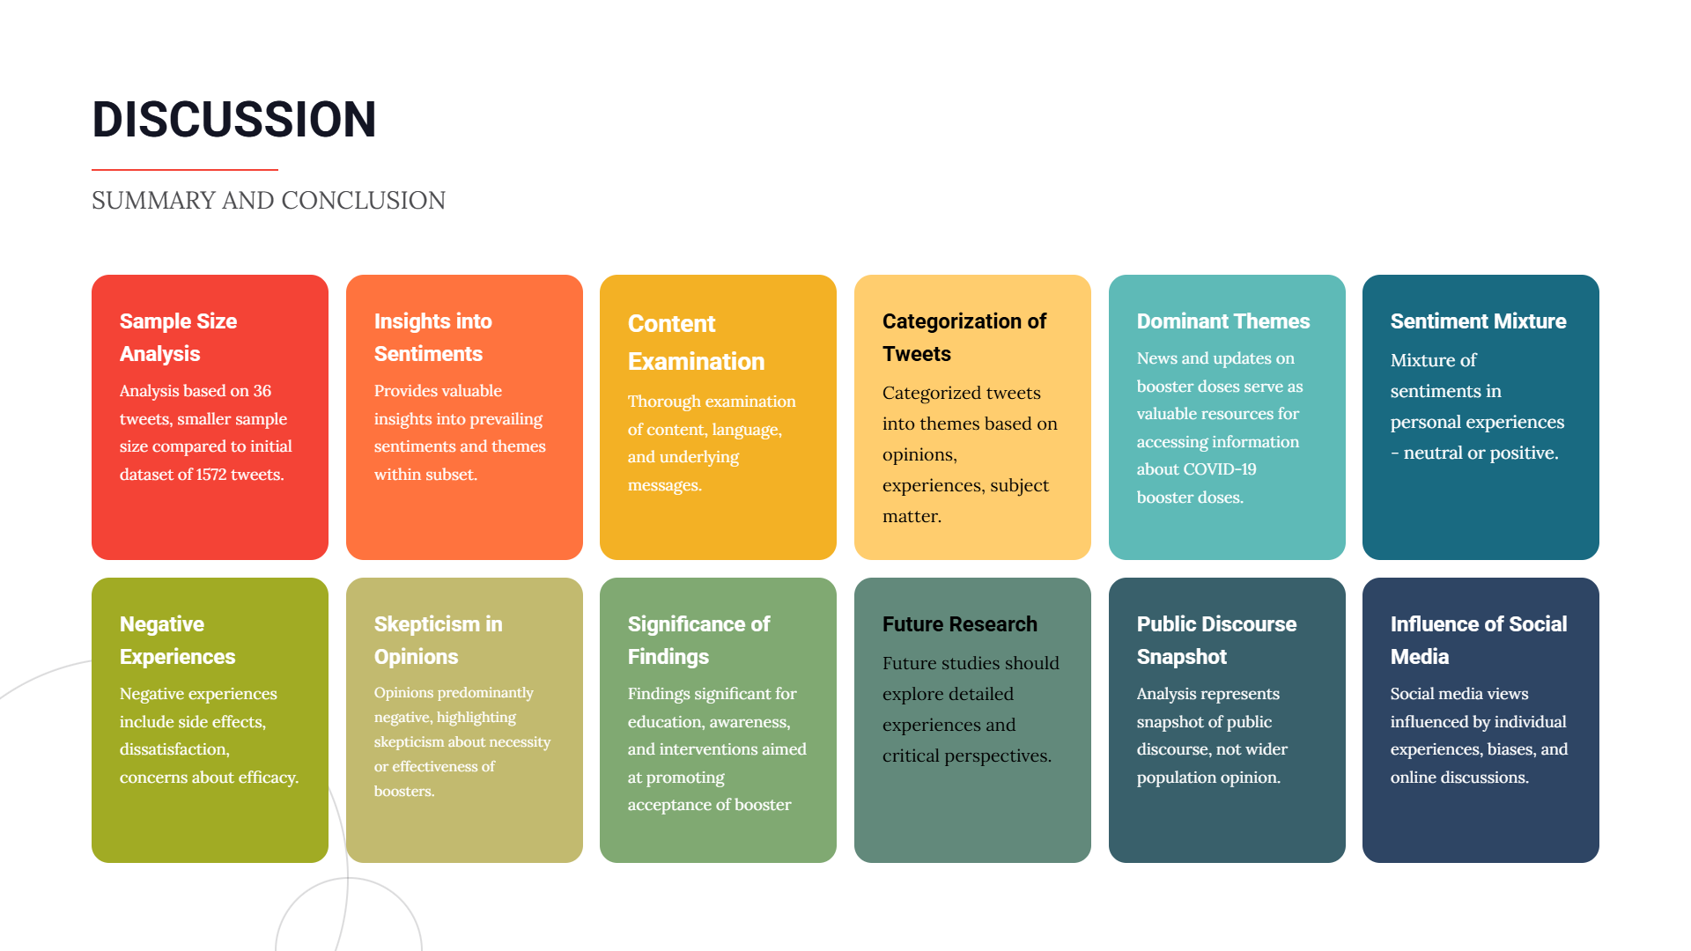

Slide 23
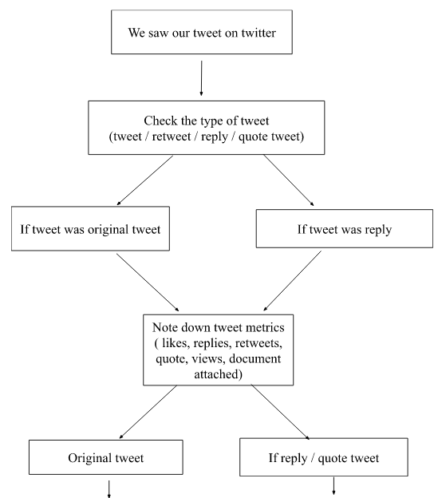
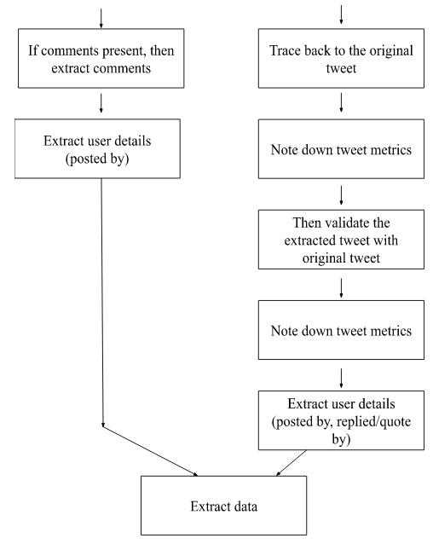
Workflow of Tweet Analysis

Slide 24
References
Harapan H, Itoh N, Yufika A, et al. Coronavirus disease 2019 (COVID-19): A literature review. Journal of Infection and Public Health. 2020;13(5):667-673. doi: https://doi.org/10.1016/j.jiph.2020.03.019
Fong MW, Gao H, Wong JY, et al. Non Pharmaceutical Measures for Pandemic Influenza in Non Healthcare Settings—Social Distancing Measures. Emerging Infectious Diseases. 2020;26(5):976-984. doi: https://doi.org/10.3201/eid2605.190995
World. Vaccine efficacy, effectiveness and protection. Who.int. Published July 14, 2021. Accessed March 15, 2023. https://www.who.int/news-room/feature-stories/detail/vaccine-efficacy-effectiveness-and-protection
Union Minister DrJitendra Singh says, India has developed four indigenous Vaccines in just two years. Pib.gov.in. Published 2023. Accessed May 20, 2023. https://www.pib.gov.in/PressReleasePage.aspx?PRID=1894167#:~:text=2022)%3B3.,GEMCOVAC%E2%84%A2%2D19%20%2D%20World's%201st%20and,India's%20indigenously%20developed%20mRNA%20vaccine.
5. Super User. Vaccine information, ICMR New Delhi - COVID-19 Vaccine. Icmr.org.in. Published 2022. Accessed May 20, 2023. https://vaccine.icmr.org.in/covid-19-vaccine
6. COVID-19 Vaccines with WHO Emergency Use Listing. WHO - Prequalification of Medical Products (IVDs, Medicines, Vaccines and Immunization Devices, Vector Control). Published November 3, 2021. Accessed May 20, 2023. https://extranet.who.int/pqweb/vaccines/vaccinescovid-19-vaccine-eul-issued

Slide 25
Home and Personal Care Market

Slide 26
HOME AND PERSONAL CARE MARKET
Drivers
Urbanization and rising disposable income
Growing concern for health and beauty
Health, hygiene & wellness awareness
Technological advancements in formulation and packaging.
Challenges
Rising cost in mass market
Regulatory and compliance hurdles
Sustainability and waste management issues
Lack of awareness in rural areas
Digital misinformation and greenwashing
Opportunities
Expansion of natural organic ayurvedic products
Personalization and technology driven solutions
Growth of E-commerce & D2C brands

Slide 29


